Slide 1




Computer
Hardware
Class V
lab 2

Slide 2
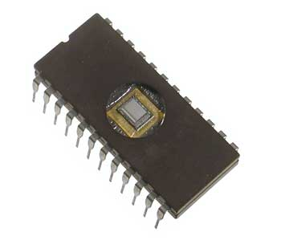
ROM
ROM is a storage medium that is used with computers and other electronic devices

Slide 3
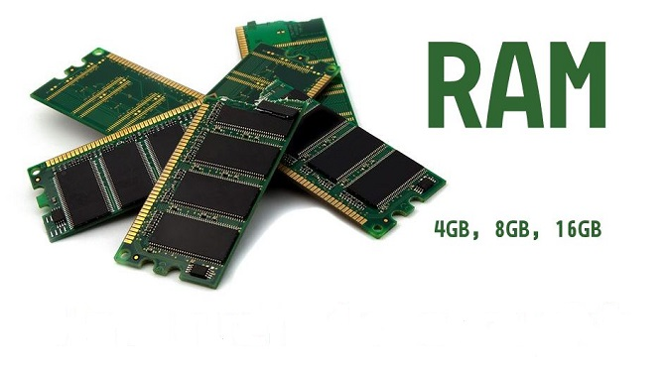
RAM
RAM (random access memory) is a hardware device that allows information to be stored and retrieved on a computer

Slide 4
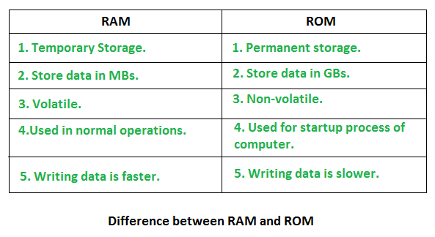
RAM vs ROM

Slide 5
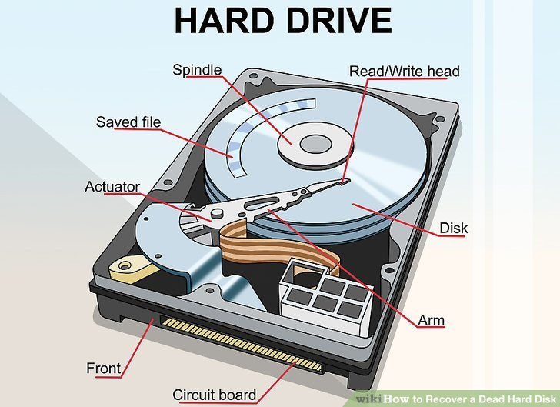
Hard Disc
electro-mechanical data storage device

Slide 6
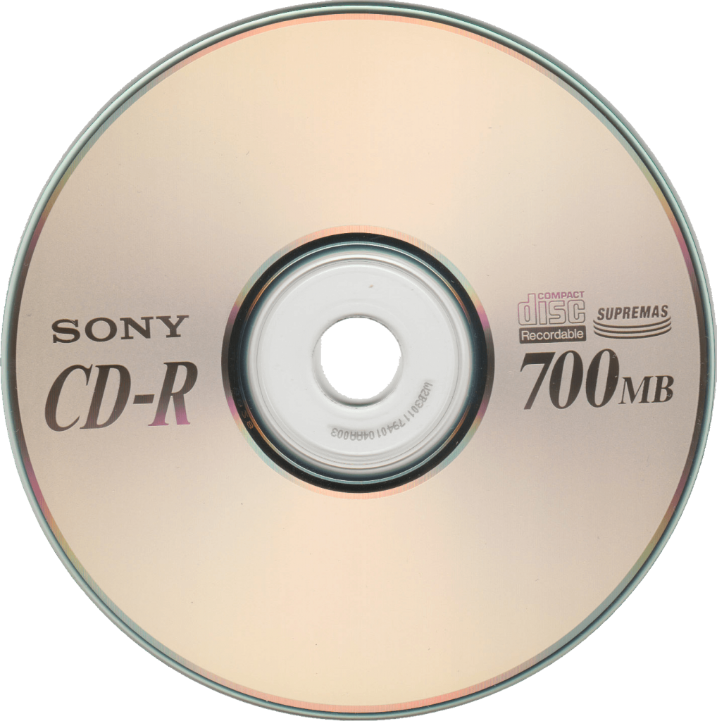
CD vs DVD
both are portable storage medium. CD can store upto 700 MB where a DVD can store upto 4.7 GB

Slide 7


